Slide 1
Office 365 Development

Slide 2
O3656-8 Developing advanced Taxonomy Scenarios in Office 365
Speaker
Speaker

Slide 3

Agenda
Motivation
Managed Metadata Service Architecture
Creating Termsets and Terms
Creating Termsets Using CSOM

Slide 4
Motivation

Slide 5















Vision
EXTEND OFFICE EVERYWHERE
CONNECT TO OFFICE 365 SERVICES
BUILD USING AN OPEN PLATFORM
Delve
z
Users and groups
Files
Mail
Calendar
My Apps
Video Portal
Contacts
Office Graph
Presentations
Documents
Spreadsheets
Lync
OneNote
Yammer

Slide 6

SharePoint App Building Blocks
SharePoint Apps
aspx
Databases
png
master
CSS
js
Web Services
SharePoint
REST
CSOM
SharePoint API
Managed
Metadata
Search
Service
Workflow
Service
BCS
List and Libraries
Service Applications

Slide 7
Why Use Managed Metadata?
Tag list items and documents with metadata
Use managed taxonomies to improve search & navigation
Use enterprise content types across site collections

Slide 8
Managed Metadata Service Architecture

Slide 9
Managed Metadata Service
Managed Metadata Service Application
Term Store
Content Type syndication
SharePoint Metadata Manager
Notes:
Managed Metadata service application:
Admins define term store (taxonomy).
Admins define the location of the Enterprise Content Type site collection hub.
Metadata Manager = utility used to manage the term store.
Admins can import a CSV file that contains a taxonomy into a new term store.
SharePoint 2010 now has a Managed Metadata field type that’s bound to a term set and used in tagging of List Items.

Slide 10
The Term Store
MMS built on top of term store database
Tracks metadata used to tag items and documents
Administrators create the metadata
Users apply metadata by tagging items and documents
Structure of managed metadata
Group
Term set
Term

Slide 11
Term Sets
Flat
Red
Blue
Hierarchical
North America>USA>Texas>Paris
Europe>France>Paris
Taxonomy
Structured Controlled
Generally Closed
Folksonomy
Unstructured
Generally Open
Notes:
Term sets can be flat like a list of colors or hierarchical like a list of Continents > Countries > States > Cities. Generally curated term sets are “closed” and managed centrally, but you can also create them “open” and let users add to them.

Slide 12
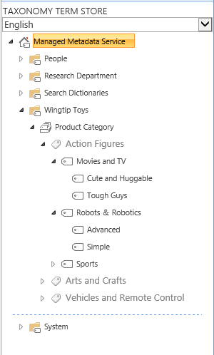
Understanding Terms and Term Sets
Term Store
Term Group
Term Set
Term
Term
Term
Notes:
The term store is hierarchical. Create a term group for a specific use and then create Term Sets that contain terms and sub terms.

Slide 13
Managed Metadata Improvements
Metadata leveraged in various ways throughout SharePoint 2013
New pages introduced so not everyone has to use Term Store Manager to modify taxonomies
Permissions for groups
SharePoint 2010 allowed read
SharePoint 2013 supports read/write
Numerous features based on taxonomy targeting WCM scenarios
Ability to flag a term set’s “intended use”
Taxonomy API exposed via CSOM
Notes:
The major WCM improvement introduced in SharePoint 2013 is the feature that enables the use of a Term Set for Navigation. Managed Navigation uses the tags on a WCM page to drive navigation.

Slide 14
Term Store Manager Improvements
Cross site collection term access for private groups
Possibility to link different site collections to see others terms
Pinning terms
Read only reuse of the term in alternative location in the hierarchy
UI for custom property editing
Specific by location properties
Indication of the term set usage for other SharePoint 2013 uses
Additional Multilingual support
Flexible LCID & automated translation support
Block users from using keywords outside of specific term set
Notes:
Block users from using this keyword outside the context of its new Term Set destination.

Slide 15
Enterprise Content Types
Content types often scoped at site level
Cannot see the same set across site collections
MMS allows syndication of “enterprise” content types
Define one site collection as the content type hub
Enterprise content types are read only in sites
Sites can have enterprise and local content types in sites
Local content types can inherit from enterprise content types
Notes:
Enterprise Content Types allow for consistent content types across multiple SharePoint site collections, web applications and farms.
In the Managed Metadata Service you can define a site collection that will serve as a central repository of content types.
Content types that are syndicated can’t be changed in the child sites, but site owners can create new content types that extend them to implement changes.

Slide 16
Enterprise Content Types
Central Store of Content Types
Published to Subscribed Site Collections
Republished when Source is Updated
In Subscriber Site
Cannot Edit Source Content Type
Create New Content Types that Inherit
Notes:
In early versions of SharePoint it was a challenge to keep content types synchronized across Site Collections. In 2010 the Managed Metadata Service was enhanced to Publish certain Content Types to all site collections as Enterprise Content Types. They are read only in the subscribing site collection, but can be inherited from.

Slide 17
Creating Termsets and Terms

Slide 18
Metadata Manager
Provides UI for managing term sets and terms
Import of term sets and terms
Manage custom properties
Translations & synonyms
Manage term set / term languages
Submission policy (open / closed)
Open means users can submit terms to the term store (when adding / editing items)
Regardless of the policy, users can always submit keywords
Notes:
The metadata manager offers full control over the management of the terms within term sets.
Terms and custom properties can be managed using the Browser interface or the SharePoint Object Model. The classes reside in the Microsoft.SharePoint.Taxonomy namespace of the Microsoft.SharePoint.Taxonomy.dll. The namespace holds classes like:
TaxonomySession
TermStore
Group
TermSet
Term
The term set policy can be set to:
Open – anyone can contribute to it.
Closed – only admins can contribute to it.

Slide 19
Creating a Taxonomy
Steps to creating a taxonomy
Create a new group
Create a new term set
Create top-level terms
Create hierarchy of child terms

Slide 20
demo
Creating and using a Custom Termset

Slide 21
Creating Termsets Using CSOM

Slide 22
Managed Metadata CSOM
SharePoint 2013 CSOM has support for taxonomy
Add references to:
Microsoft.SharePoint.Client.dll
Microsoft.SharePoint.Client.Runtime.dll
Microsoft.SharePoint.Client.Taxonomy.dll
CSOM usage is usage very similar to server-side taxonomy API
Obtain TaxonomySession reference followed by
Term Store
Group
Term Set
Terms
Load objects & collections as necessary
Notes:
The ECM client object model is available in .NET Framework libraries (.NET Framework client and Microsoft Silverlight) and JavaScript script files. The client object model enables developers to access metadata and other ECM APIs from the client. This is especially useful in scenarios where reading content is a higher priority than administering it or authoring it, and where SharePoint Server 2013 needs to enable a cloud scenario (SharePoint Online) for a subset of functionality that is available on-premises.

Slide 23
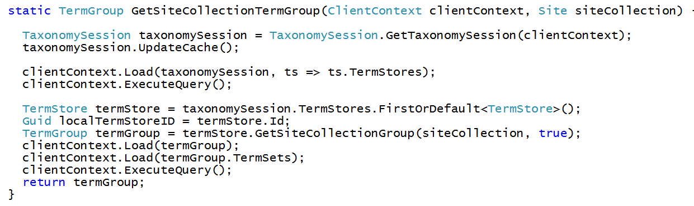
Using the Local Termset Groups

Slide 24
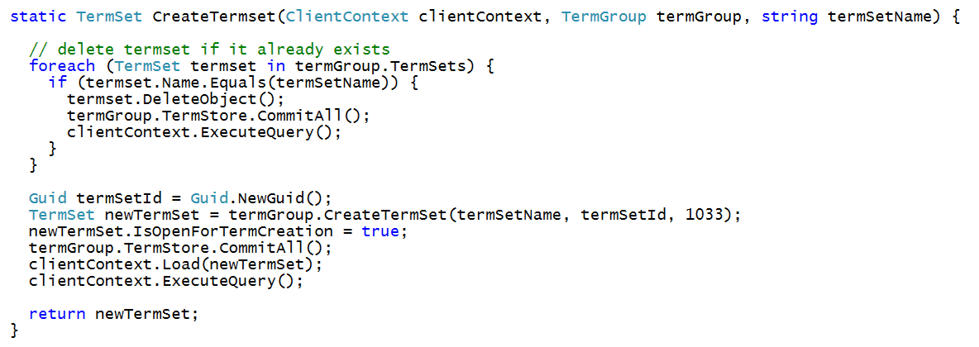
Creating a Termset

Slide 25
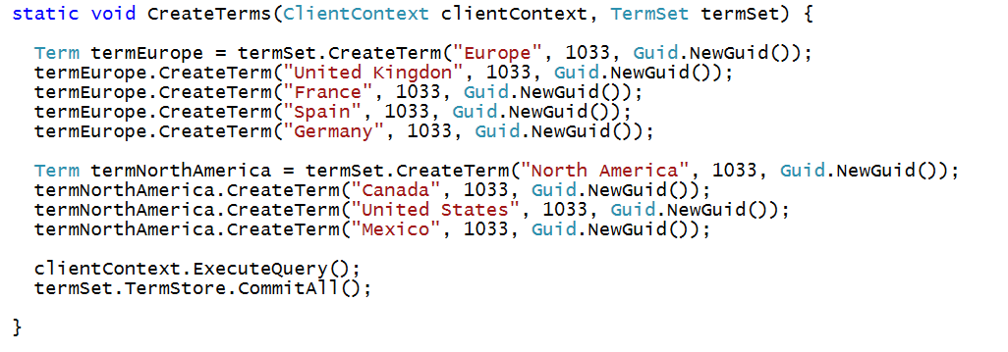
Creating Terms

Slide 26
demo
Creating a termset and a list that uses it using CSOM

Slide 27
Summary
Motivation
Managed Metadata Service Architecture
Creating Termsets and Terms
Creating Termsets Using CSOM

Slide 28
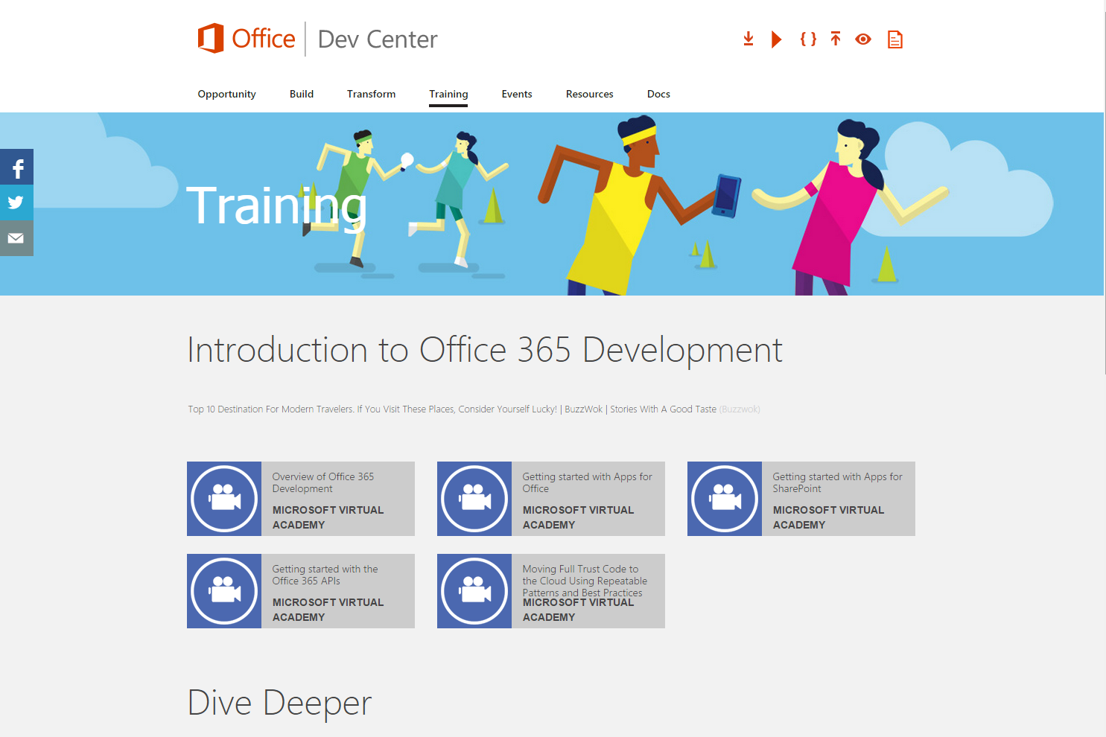
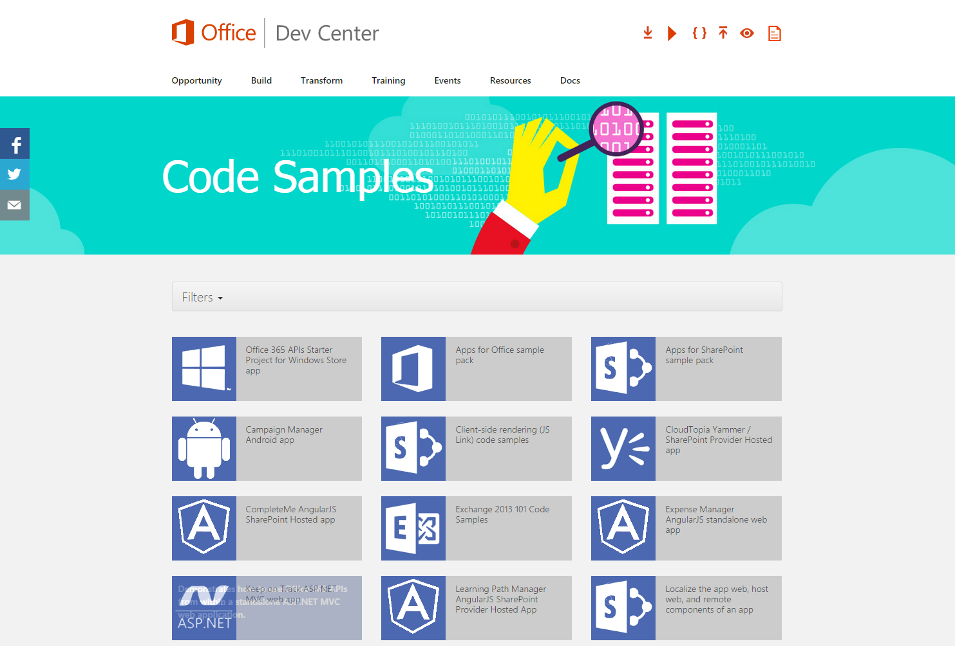
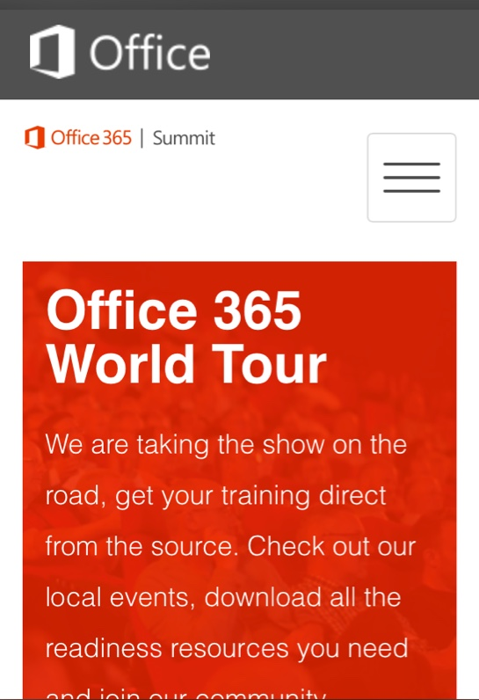
dev.office.com
Sign up
http://dev.office.com/getting-started
Explore
http://apisandbox.msdn.microsoft.com
Get trained http://dev.office.com/training

Slide 29


Feedback
Office 365 Network Share you best practices and join conversations https://www.yammer.com/itpronetwork
Stackoverflow Ask deep technical questions to a world-wide set of developers
http://stackoverflow.com/questions/tagged/ms-office
UserVoice Provide suggestions of what you want in future versions
http://officespdev.uservoice.com/

